Slide 1
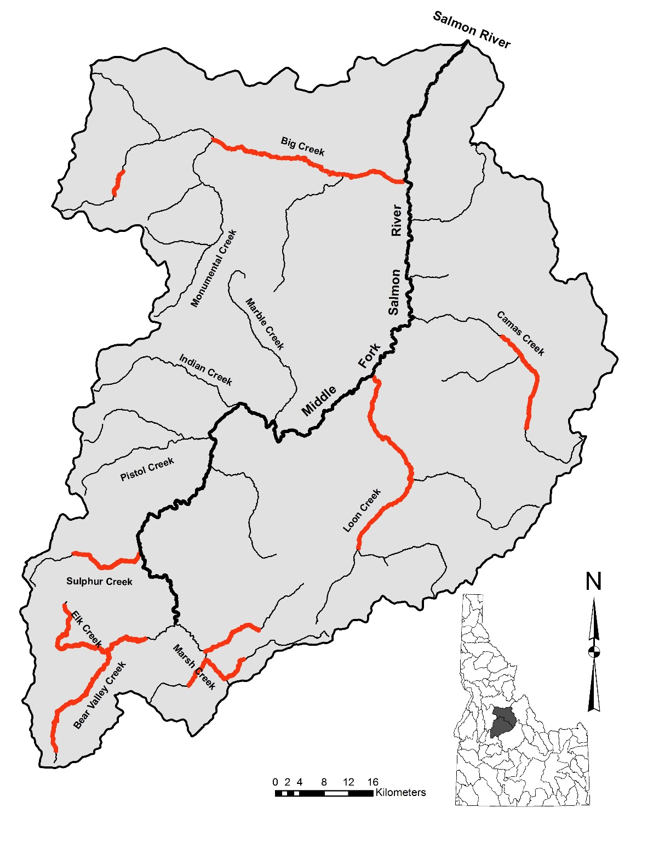
Rapid River

Slide 2
180
2001
2002
160
2003
140
Aerial Count
Commission
2004
120
2005
100
80
60
40
Omission
20
0
0
20
40
60
80
100
120
140
160
180
Census

Slide 3
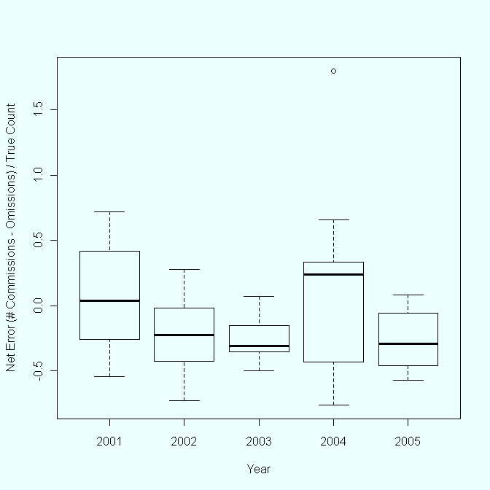
Temporal Variation
Net Error by Year
1.5
1
Net Error
0.5
0
-0.5
Grand mean = -0.10553
2001
2002
2003
2004
2005

Slide 4
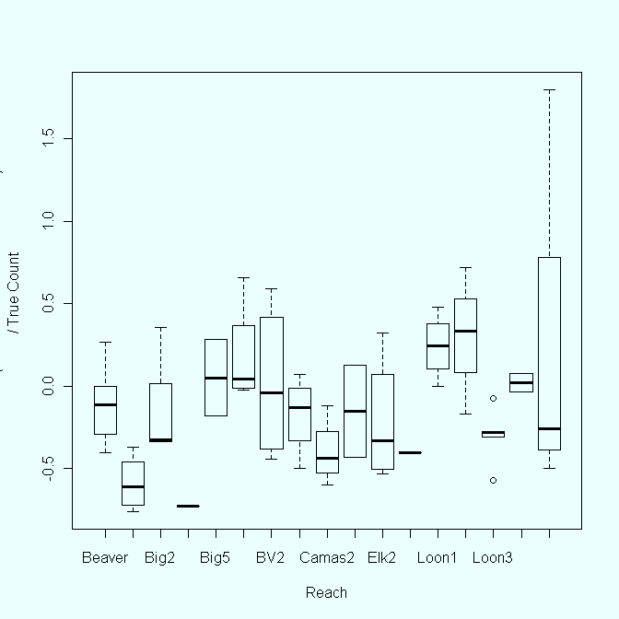
Spatial Variation
Net Error by Site
1.5
1
0.5
Net Error
0
-0.5
Grand mean = -0.10553
Beaver
Camas 1
Elk 2
Elk 3
Loon 1
Marsh 1
Sulph 2
Big 5
B-Valley 2
Loon 2
Loon 3
Big 1
Big 2
Big 3
B-Valley 1
Camas 2
Camas 3

Slide 5
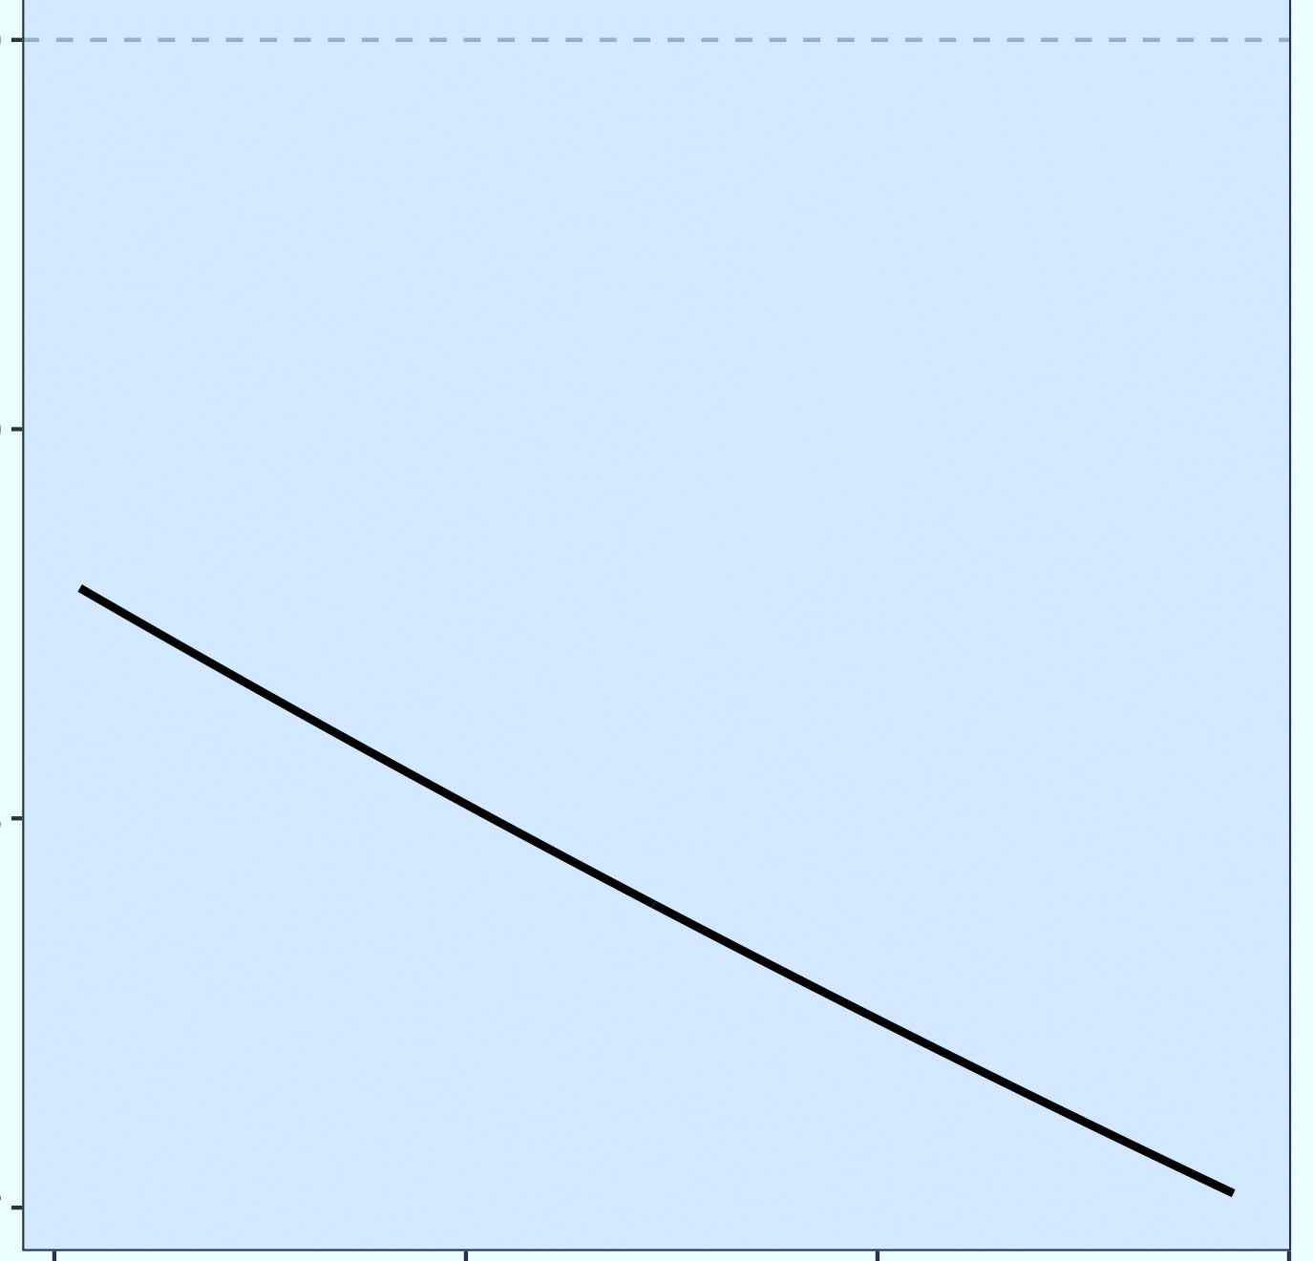
1
0.9
Fraction of True Count
0.8
0.7
Redd Density

Slide 6
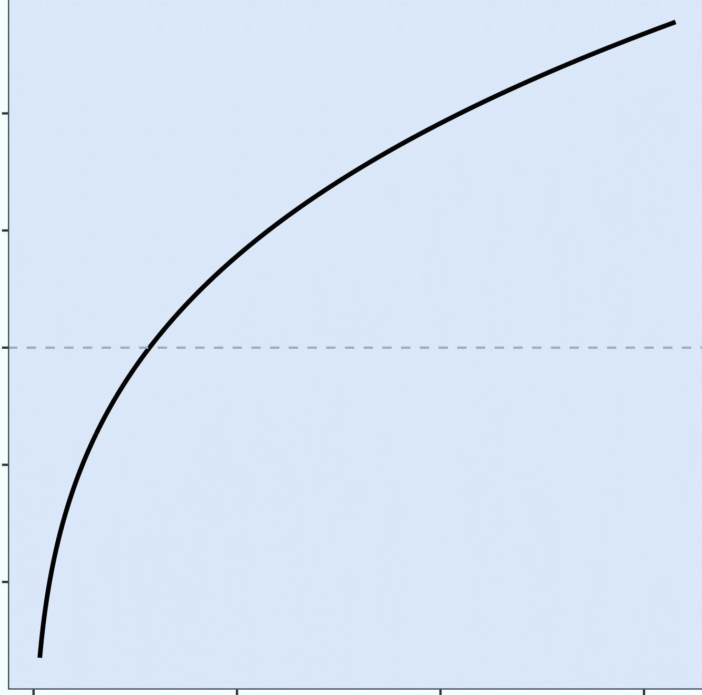
1.4
1.2
1
Fraction of True Count
0.9
0.8
Distance Between Redds
0
200
400
600

Slide 7
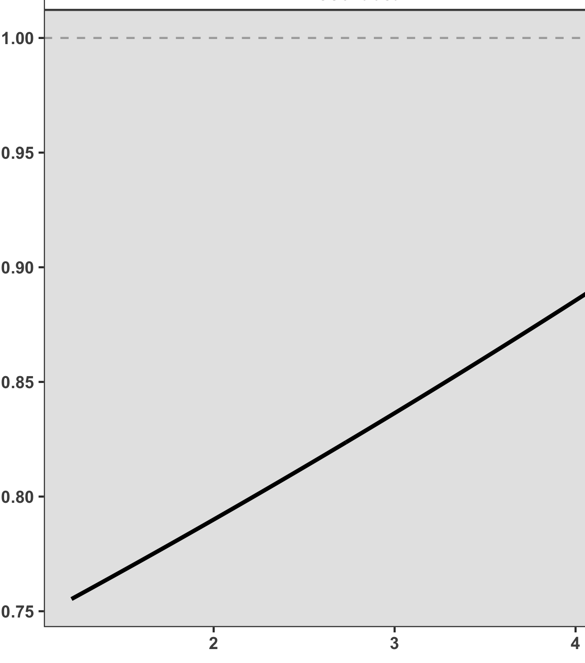
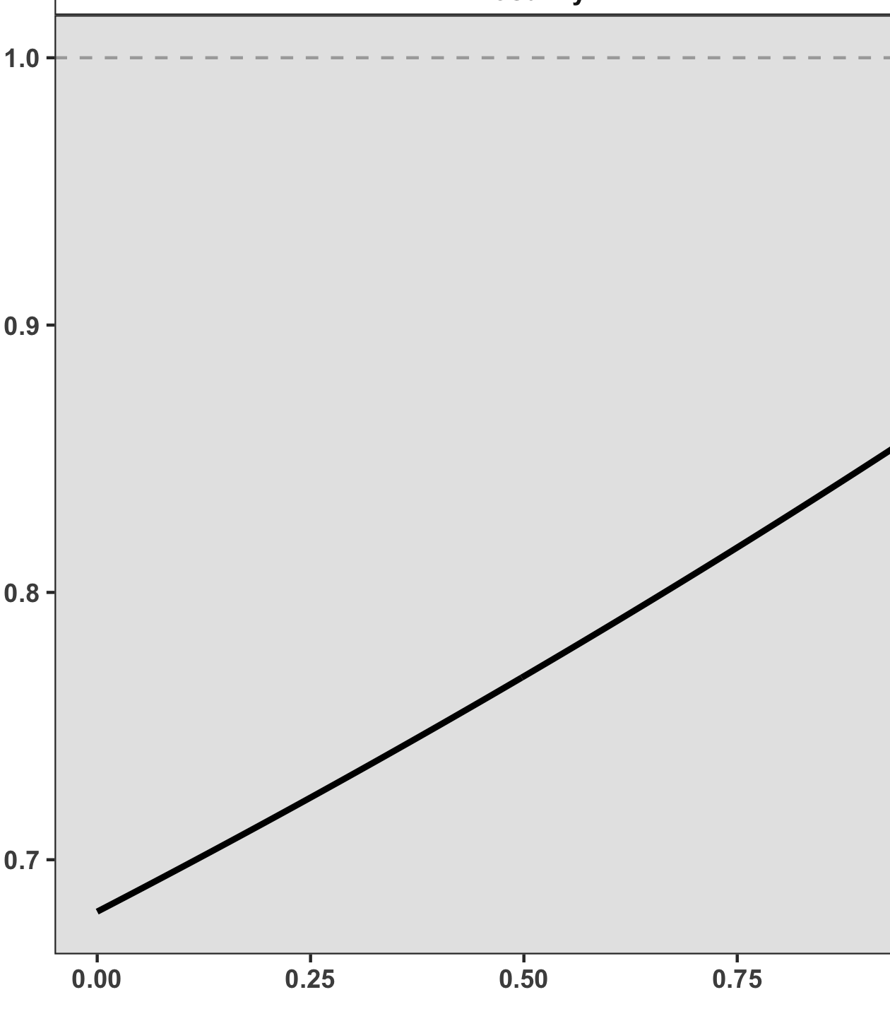
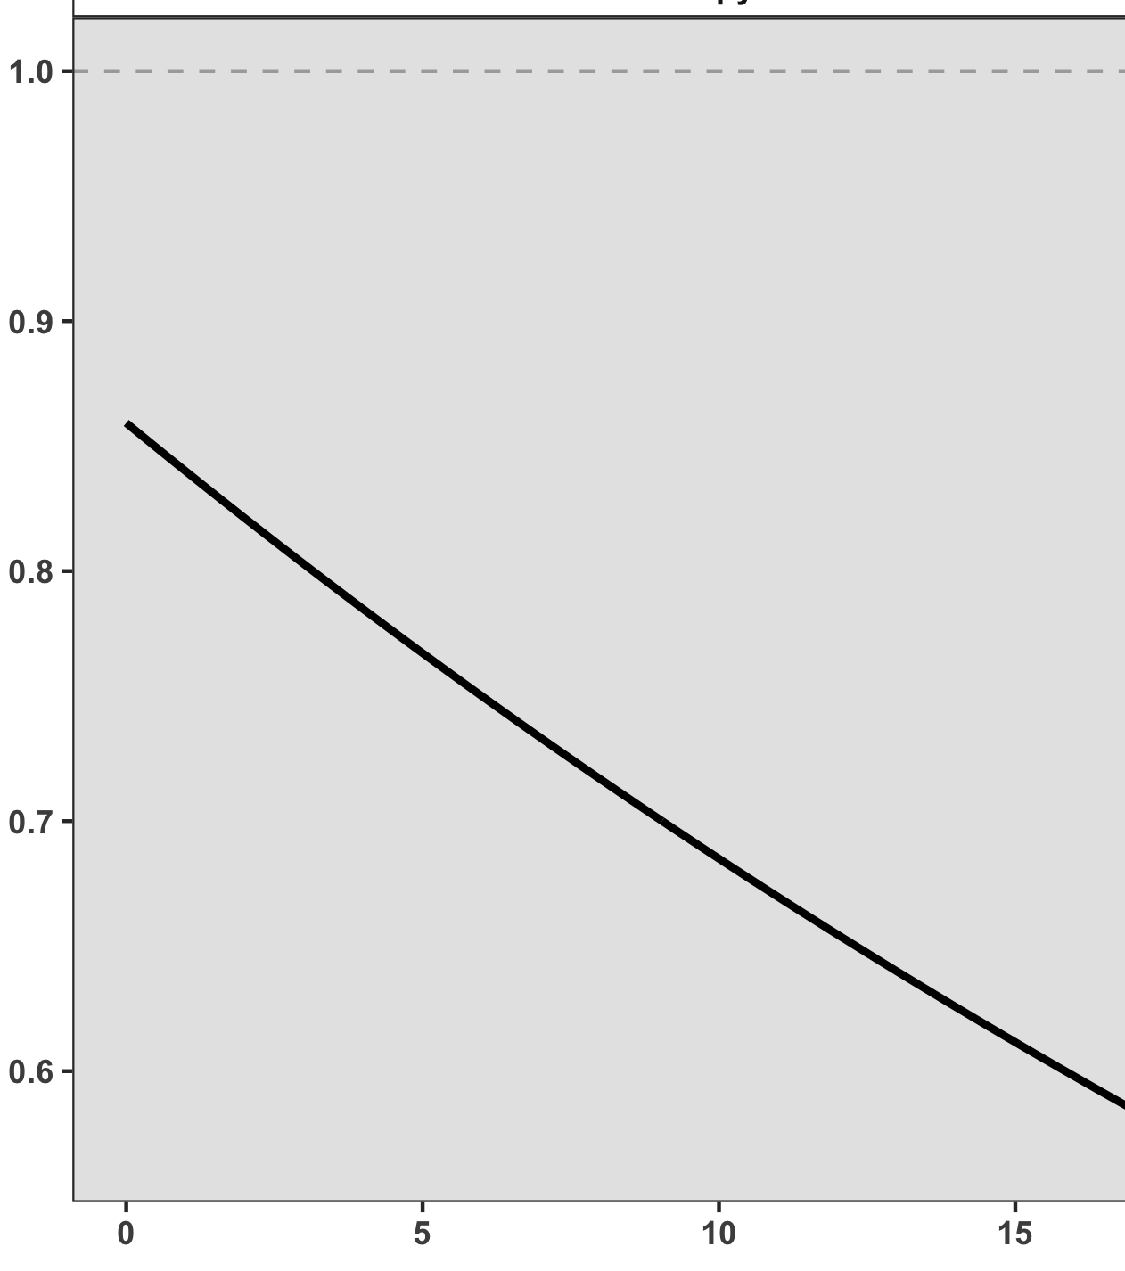
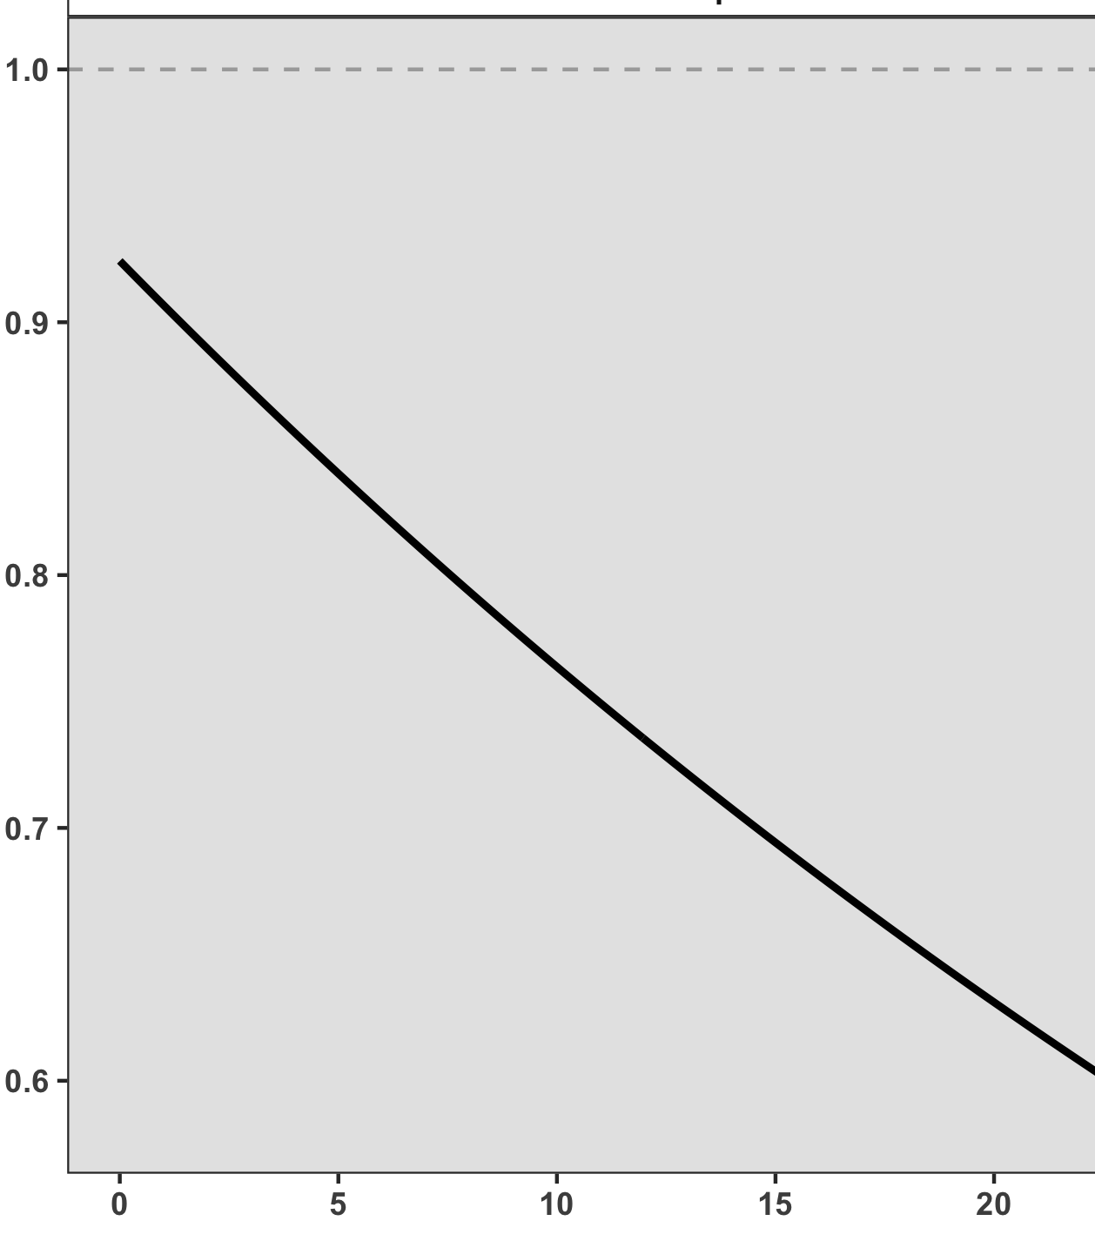
Substrate Contrast
Sunlight
Key Predictor Variables
Leave-
One-
Out-
Validation
Model
Fraction of True Count
Canopy
Redd Overlap

